Slide 1
AASD4011: Mathematical Concepts for Deep Learning
Introduction to Deep Learning

Slide 2
“What is deep learning?”
What would be your answer?

Slide 3
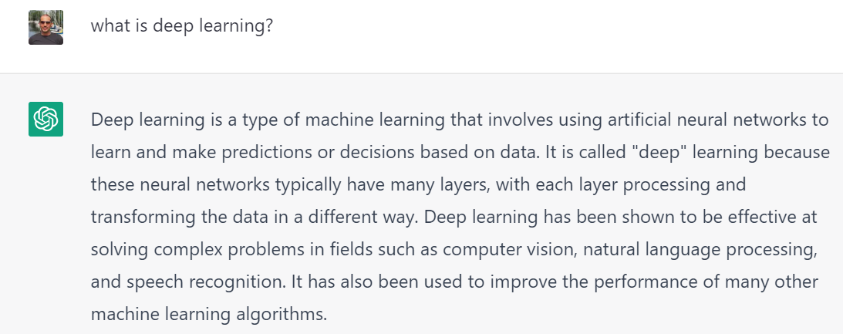
What is Deep Learning?
OpenAI’s ChatGPT, a Deep Learning model,
answers the question “what is deep learning” as follows:
Human:
Chat GPT:
OpenAI ChatGPT, retrieved on December 2022

Slide 4
What is Deep Learning?
Human:
1
2
Chat GPT:
4
3
Let’s examine these four elements
(and see how accurate ChatGPT is)
OpenAI ChatGPT, retrieved on December 2022

Slide 5
What is Deep Learning?
Human:
1
2
Chat GPT:
4
3
Let’s examine these four elements
(and see how accurate ChatGPT is)
OpenAI ChatGPT, retrieved on December 2022

Slide 6
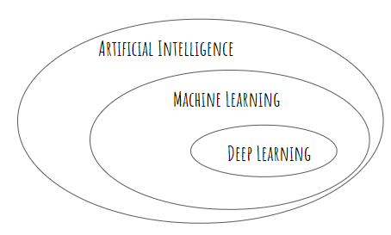
“Deep Learning is a Type of Machine Learning”
But what is Machine Learning?
After Chollet, Chapter 1

Slide 7


Deep Learning is a Type of Machine Learning
Artificial intelligence is intelligence demonstrated by machines
Artificial Intelligence: The capacity of computers or other machines to exhibit or simulate intelligent behavior
Artificial intelligence is intelligence - perceiving, synthesizing, and inferring information - demonstrated by machines, as opposed to intelligence displayed by animals and humans.
OED, Retrieved December 2022; Wikipedia, Retrieved December 2022

Slide 8
Deep Learning is a Type of Machine Learning
Machine Learning – methods for achieving intelligence demonstrated by machines, where the intelligence was acquired by learning from experience (data)
Machine Learning - the study of computer algorithms that improve automatically through experience.
Tom Mitchell's widely quoted definition of machine learning:
Machine Learning - A computer program is set to learn from an experience E with respect to some task T and some performance measure P if its performance on T as measured by P improves with experience E.
Wikipedia, Retrieved December 2022; Russell & Norvig (2003), pp. 649–788.

Slide 9
Deep Learning is a Type of Machine Learning
Deep Learning - methods for achieving intelligence demonstrated by machines, where the intelligence was acquired by learning from experience (data), and by using artificial neural networks.
The word “Deep” in “Deep Learning” refers to either:
A hierarchy of representations (Chollet, p.7, Goodfellow, p.1)
The number of layers in a feedforward-network or an unrolled RNN
The length of the credit assignment path (Sugiyama, p.15)

Slide 10
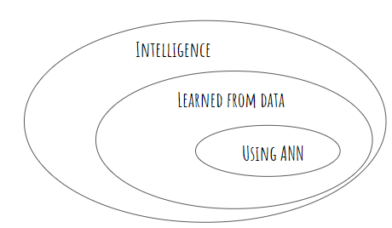
Deep Learning is a Type of Machine Learning

Slide 11
What is Deep Learning?
Human:
1
2
Chat GPT:
4
3
OpenAI’s ChatGPT, a Deep Learning model, answers the question “what is deep learning?”.
OpenAI ChatGPT, retrieved on December 2022

Slide 12
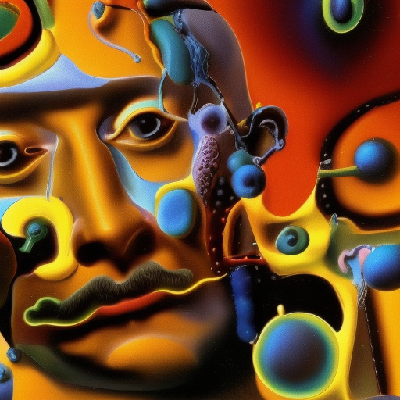
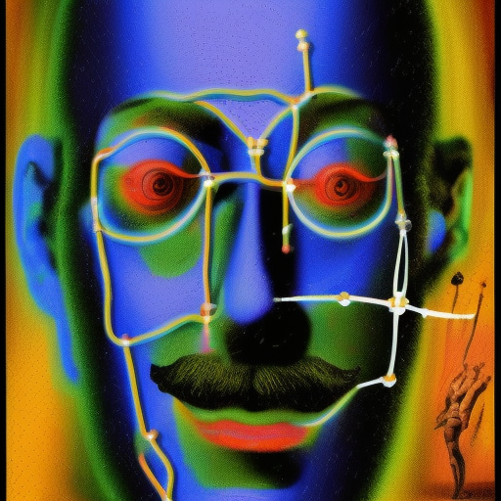
“Artificial neural network in the style of Salvador Dalí”
Produced with DreamStudio, by StableAI

Slide 13
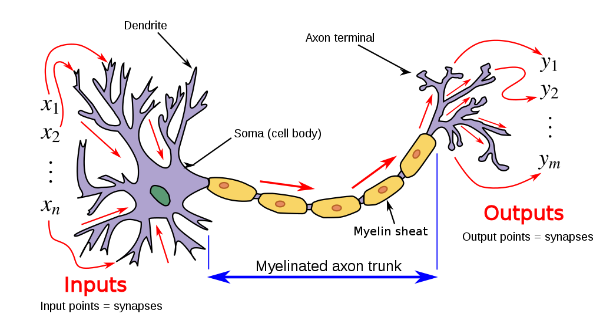
The Biological Neuron Analogy
A Biological Neuron
By Egm4313.s12 , Wikipedia

Slide 14
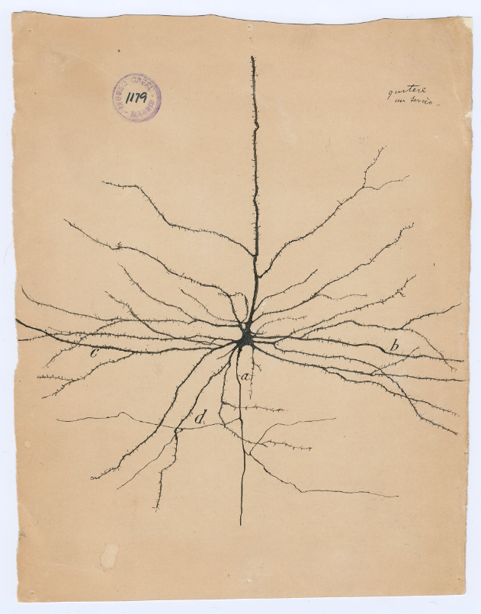
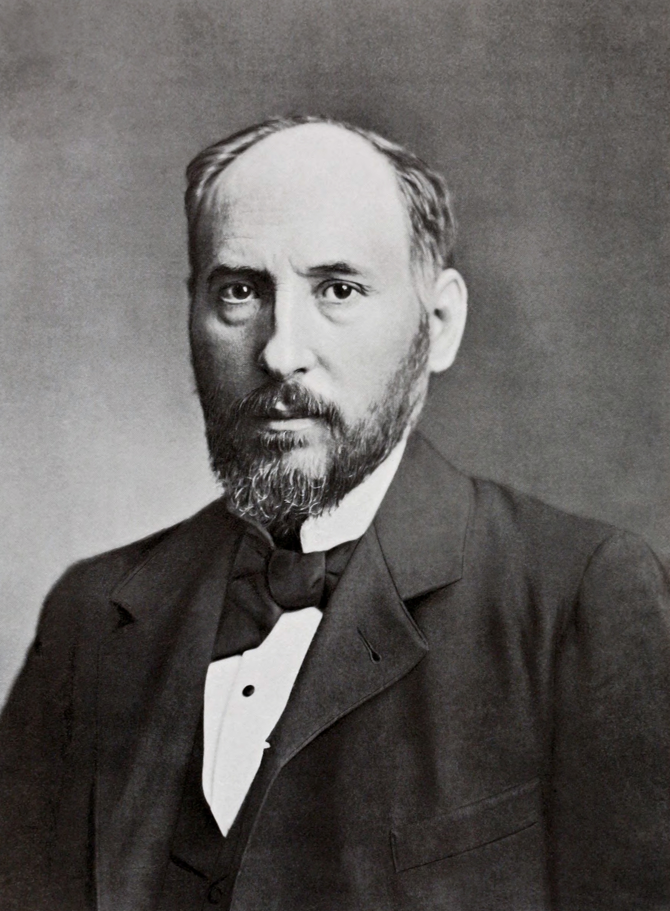
The Biological Neuron Analogy
A Biological Neuron
Wikipedia
Santiago Ramón y Cajal, The pyramidal neuron of the cerebral cortex, 1904, Credit: Cajal Institute (CSIC), Madrid

Slide 15
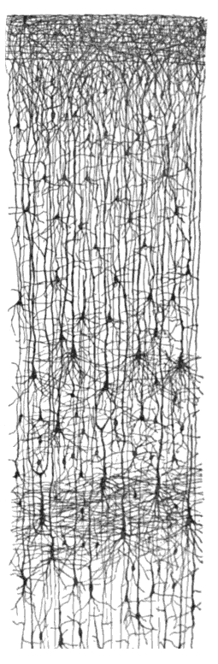
The Biological Neuron Analogy
Drawing of cortical lamination by Santiago Ramon y Cajal,
A vertical cross-section, with the surface of the cortex at the top.
(this is a Golgi-stain which shows the dendrites and axons of a random subset of neurons).
Public Domain, Retrieved from https://en.wikipedia.org/wiki/Cerebral_cortex on December 2022

Slide 16
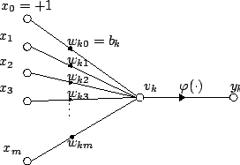


Modeling a Single Neuron
Activation Function
A
Wikipedia

Slide 17
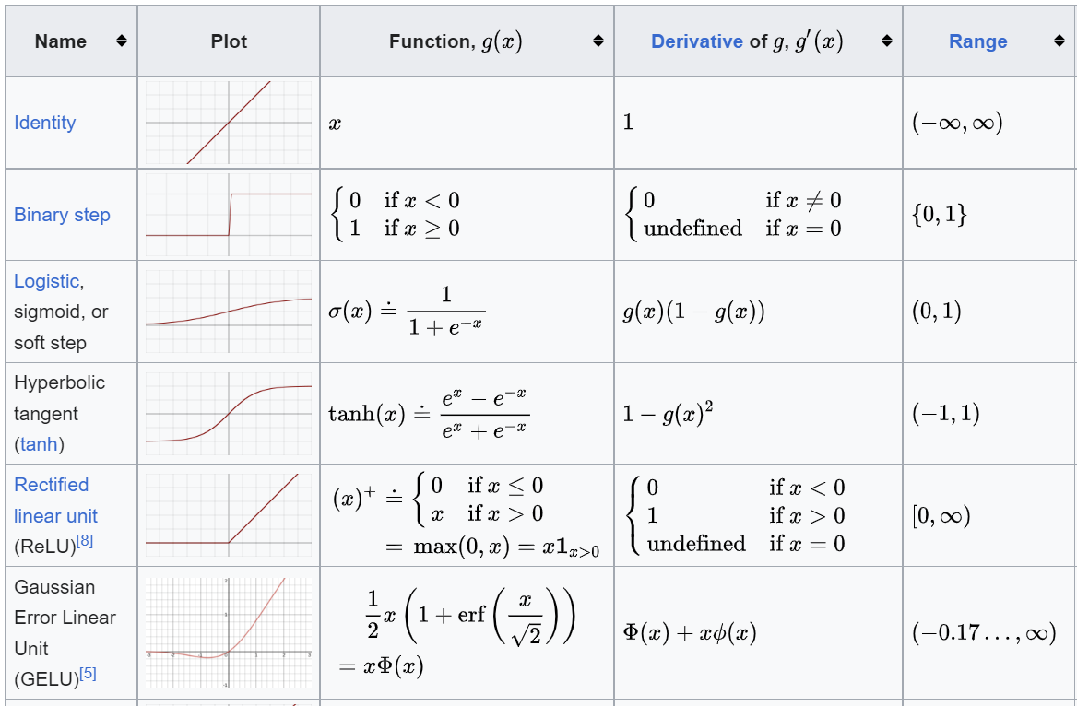
Activation Functions
Wikipedia
Wikipedia

Slide 18
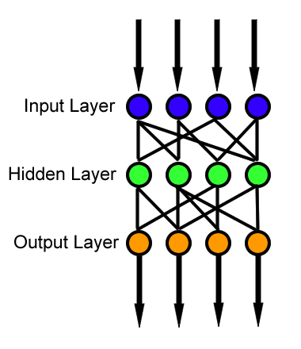
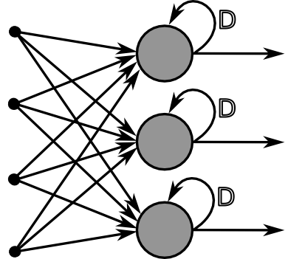
Two Types of Neural Networks
Feed-Forward
Recurrent
Directed Acyclic Graph (DAG)
Directed Cyclic Graph
Wikipedia
Wikipedia

Slide 19
Artificial Neural Network
Artificial neural networks (ANNs) -are computing systems inspired by the biological neural networks that constitute animal brains.
An ANN is based on a collection of connected units or nodes called artificial neurons, which loosely model the neurons in a biological brain.
Each connection, like the synapses in a biological brain, can transmit a signal to other neurons.
An artificial neuron receives signals then processes them and can signal neurons connected to it.
The "signal" at a connection is a real number, and the output of each neuron is computed by some non-linear function of the sum of its inputs.
The connections typically have a weights that adjusts as learning proceeds.
The weight increases or decreases the strength of the signal at a connection.
Neurons may have a threshold such that a signal is sent only if the aggregate signal crosses that threshold.
Wikipedia

Slide 20
Definition of Deep Learning
Human:
1
2
ChatGPT
4
3
OpenAI’s ChatGPT, a Deep Learning model, answers the question “what is deep learning?”.
OpenAI ChatGPT, retrieved on December 2022

Slide 21
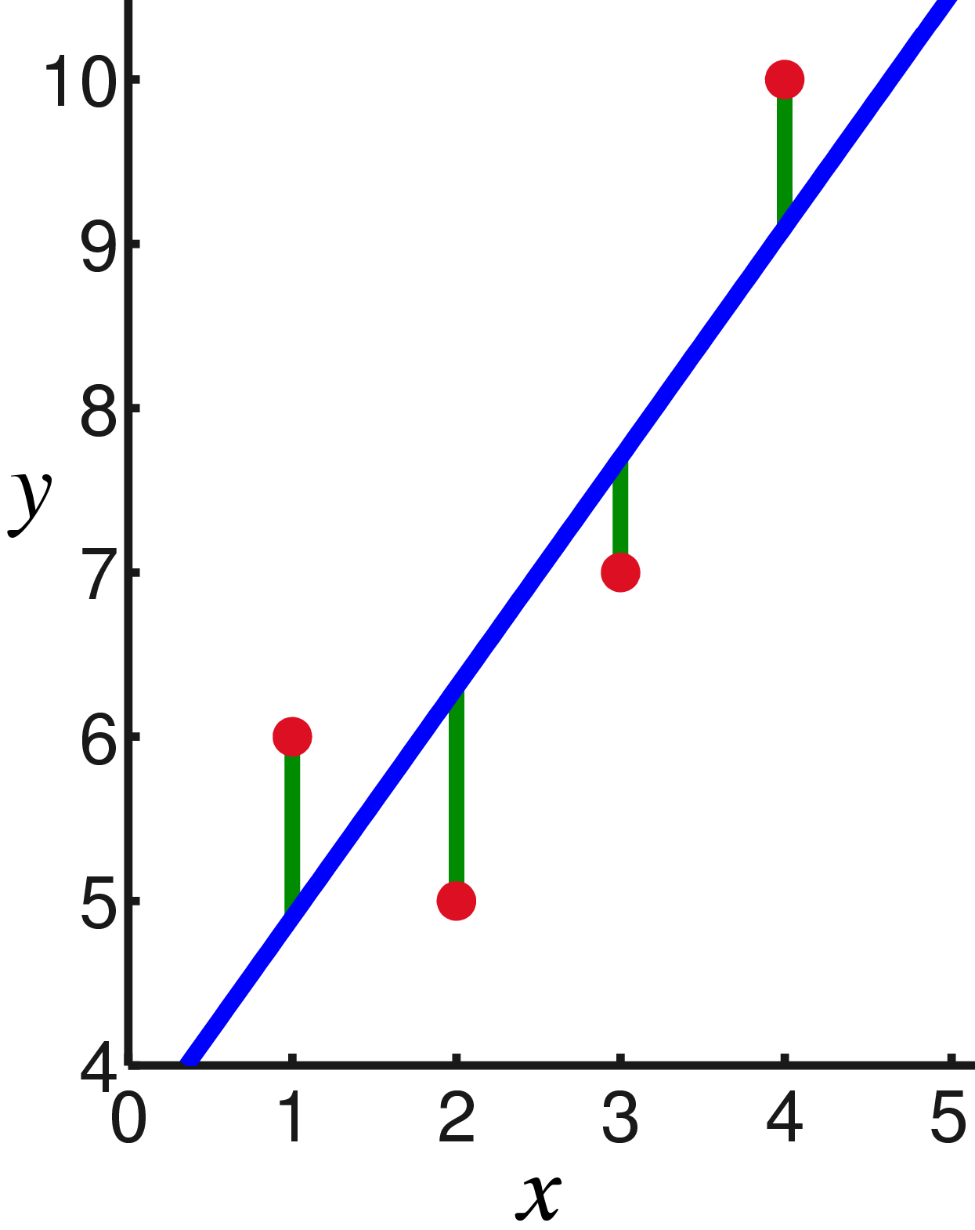

Loss Function
A loss function (or cost function) - is a function that maps values of one or more variables onto a real number intuitively representing some "cost" associated with the event, that is negatively correlated with a success measure (such as accuracy). An optimization problem seeks to minimize a loss function.
Mean Squared Error (MSE):
Linear Regression and an associated Loss Function (in green)
https://en.wikipedia.org/wiki/Mean_squared_error
By Oleg Alexandrov Wikipedia

Slide 22
Definition of Deep Learning
Human:
1
2
ChatGPT:
4
3
OpenAI’s ChatGPT, a Deep Learning model, answers the question “what is deep learning?”.
OpenAI ChatGPT, retrieved on December 2022

Slide 23

Learning with Gradient Descent
By U.S. Forest Service - Okanogan-Wenatchee National Forest, morning fog shrouds trees, Wikipedia

Slide 24
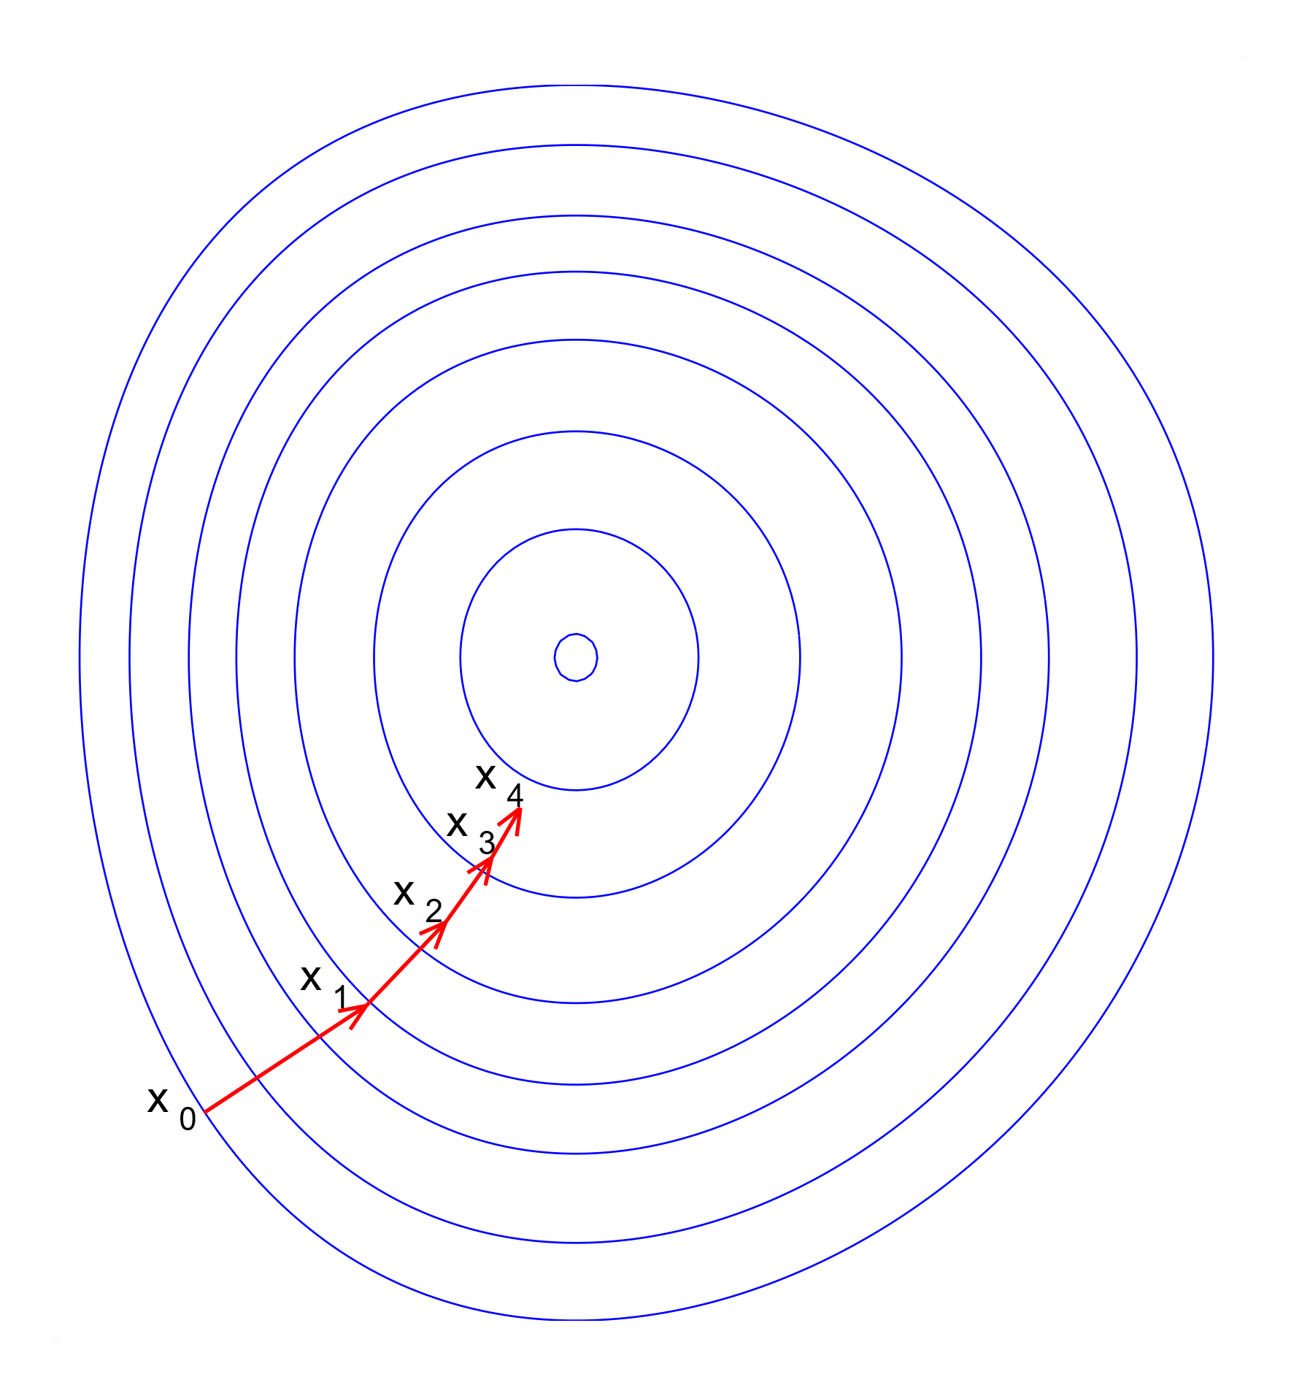
Learning with Gradient Descent
Illustration of gradient descent on a series of level sets of a 2D -> 1D convex function
Wikipedia

Slide 25
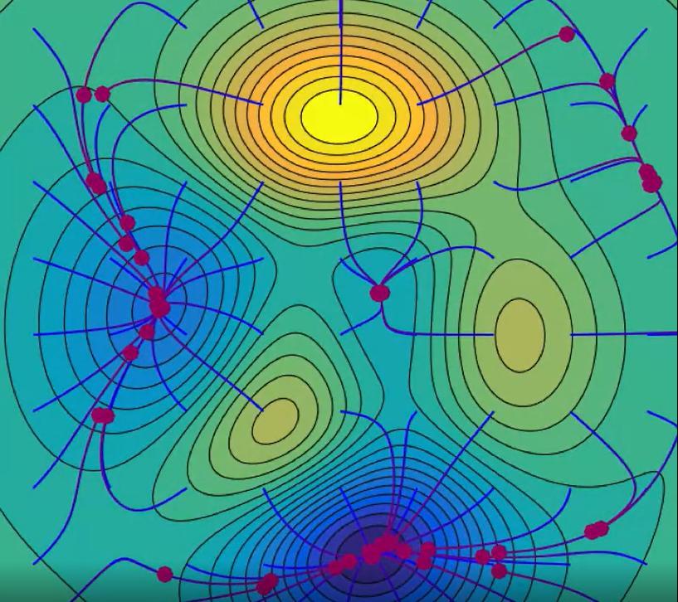
Learning with Gradient Descent
Video: https://upload.wikimedia.org/wikipedia/commons/4/4c/Gradient_Descent_in_2D.webm

Slide 26
Definition of Deep Learning
Human:
ChatGPT:

Slide 27
Take-Aways: Definitions
Deep Learning (DL) is a type of Machine Learning.
In the general sense, DL is distinguished from ML models by having many intermediate representations (Goodfellow and Chollet).
In practice, DL models are artificial neural networks (ANN), trained based on gradient descent algorithms.

Slide 28
Take-Aways: Single Neuron
An Artificial neuron sums up all of its input, and feeds it into an activation function
The activation function might be linear (‘pass-through’), or non-linear (e.g. sigmoid or a ReLU). Its output is the neuron’s output

Slide 29
Take-Aways: Loss Function
In DL, Learning from data is equivalent to training of a neural network.
During training, a neural network requires an objective by which its performance can be numerically measured, and this is the loss function.
A common loss function for regression problems in the mean squared error (MSE)

Slide 30
Take-Aways: Gradient Descent
Training a neural network is done by minimizing the value of its loss function for a given dataset.
This is done by taking small steps, in the direction opposite to the direction of the gradient. This is called gradient descent (a detailed example will appear soon).

